Slide 1
URL Structure
Mai 20, 2025

Slide 2

Understanding URLs and Their Structure
URLs (Uniform Resource Locators) are the building blocks of accessing and navigating the internet. They are used as web adresses, directing browsers to particular online resources. Understanding what URL is and how it is structured is crucial newbie learners of web development and navigating the internet.

Slide 3

What is a URL?
Definition
A URL is the full web address used to access resources like webpages, images, or files on the internet.
Purpose
It specifies the location of a resource and the protocol needed to fetch it, such as HTTP or HTTPS.
Importance
URLs make the web navigable by providing a standardized way to locate and retrieve content.

Slide 4
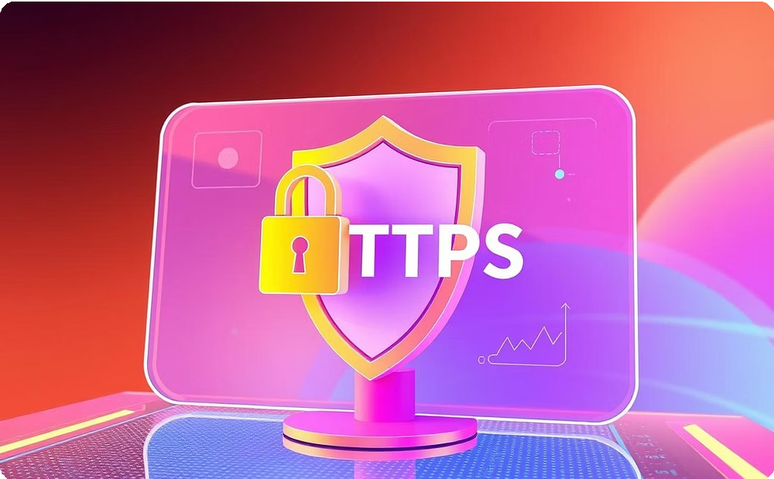
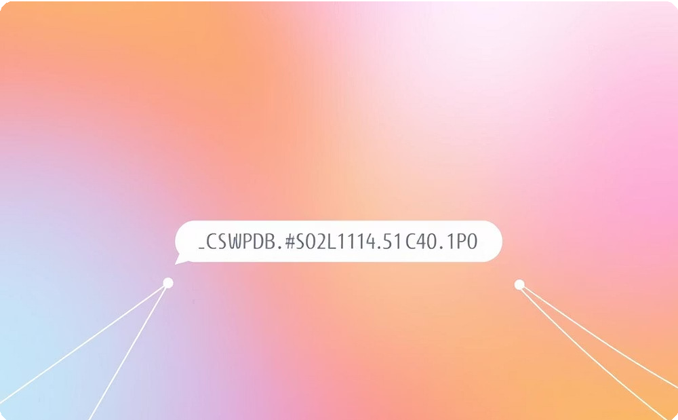
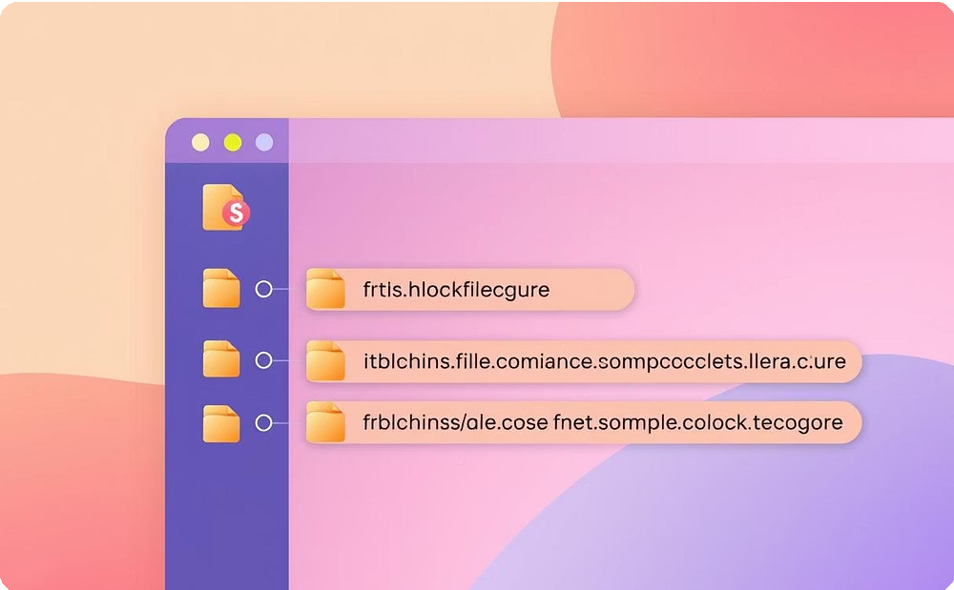
The Basic URL Structure
Protocol
The method used to access web resources, typically HTTP or HTTPS. HTTPS provides encryption to safeguard data privacy and integrity during transmission. Other protocols like FTP and mailto are used for different functions, but HTTP/HTTPS dominate in web browsing.
Domain Name
A human-friendly web address identifying a website, mapped to an IP address by the Domain Name System (DNS).
Domains have a hierarchical structure with top-level domains such as .com or
.org, often accompanied by subdomains, making URLs easy to remember and use.
Path
Indicates the specific location of a resource on the website, including directory folders, file names, and any parameters. It helps web servers locate requested files and may include query strings to deliver dynamic content.

Slide 5

URL Example and Its Structure
URL | Description
https://ent.usthb.dz/Accueil/EDT | Protocol: https
 | Domain: [Subdomain:ent, 2nd-Level-Domain:usthb, Top-Level-Domain:dz]
 | Path:/Accueil/EDT

Slide 6

Advanced URL Components
Query Parameters
Extra information sent to the server, starting with ?, used to filter or customize content.
Fragment
Identifies a specific section within a webpage, starting with for direct navigation.

Slide 7
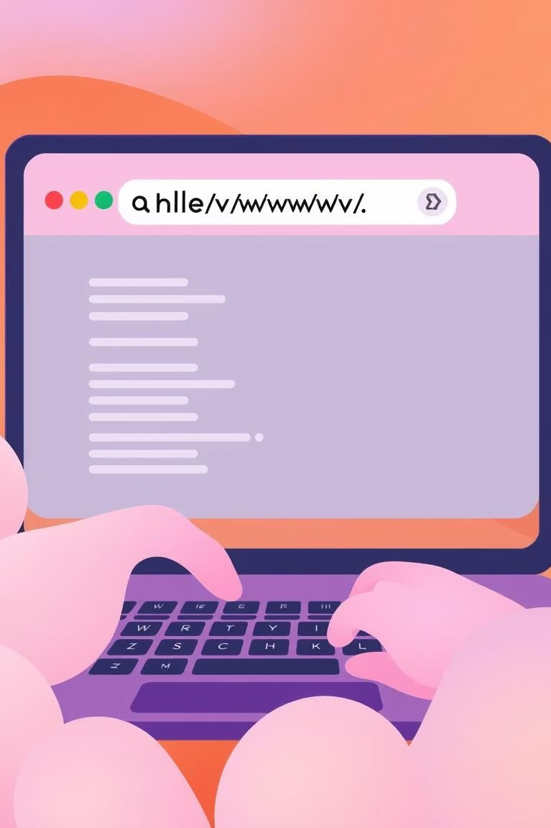
How URLs Guide Your Browser
Enter URL
Type the URL into the browser address bar.
1
Request Sent
The browser sends this URL information to the web server.
2
Content Delivered
The server responds with the requested webpage or resource.
3

Slide 8
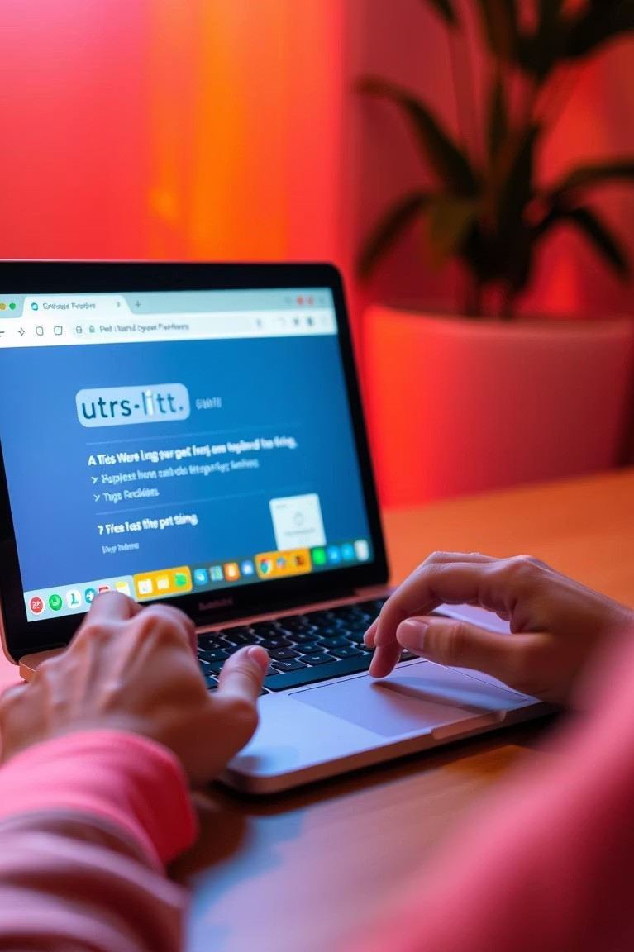
Tips for Using and Understanding URLs
Read URLs Carefully
Understanding URL components helps identify legitimate websites and avoids phishing scams.
Use Short URLs
Short and clean URLs are easier to remember and share.
Learn URL Encoding
Special characters in URLs are encoded, which is useful for developers dealing with URLs.

Slide 9

Summary and Next Steps
Understand URL Parts
Recognize protocol, domain, path, and parameters for effective web navigation.
Practice Reading URLs
Try breaking down URLs you encounter to strengthen your understanding.
Apply in Web Development
Use your knowledge to build better websites and fix navigation issues.

Slide 10
Thank You
This Project Is The Result Of The Collective Efforts Of Our Team :
- Bach Toubdji abderrahmane
- Belkheir abderrahmane
- Mansouri abdellah
- Sahraoui mohamed nail
- Yahia Bacha manil
- Amazour mohamed islam

